Slide 1

Presentation on :
Conditional Operator or Ternary Operator
in C Programming
Presented By :
Arijit Biswas Anirban
Roll : 220112
Dept. of CSE, PUST
Session : 2021-22

Slide 2
Points Covered by this presentation:
Review of Unary and Binary operators.
Introduce of Ternary Operator.
Syntax of Conditional Operator.
Problem solve using Ternary Operator.
Advantages of Conditional Operator.
Use of if…else and Ternary Operator in program.

Slide 3

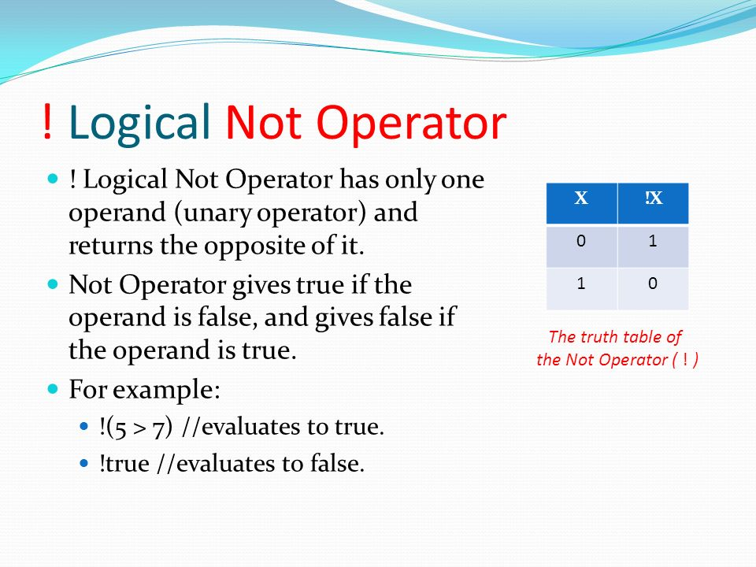
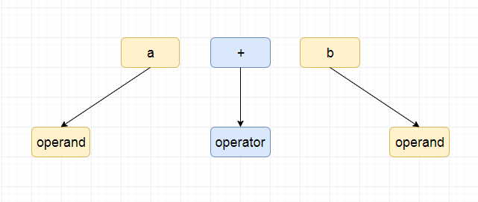
Unary Operator :
C includes a class of operators that act upon a single operand to produce a new value. Such operators are known as unary operators. The increment operator ‘++’ (i++) and the decrement operator ‘--’ (i--) are the most common unary operation. Some other unary operators are : ‘-’, ‘sizeof (type)’, ‘!’ .
Binary Operator :
Binary operators in the C are ones that operate on two operands. Arithmetic operators(+,-,*), Relational operators (<, >=, ==), Logical operators (&&,||), Assignment operators(=) and Bitwise operators(&,~) fall under the category of binary operators.

Slide 4

Introduce of Ternary Operator :
The ternary operator is an operator that takes three arguments. The first argument is a comparison argument, the second is the result upon a true comparison and the third is the result upon a false comparison. It can be used to replace lines of code with a single line.

Slide 5

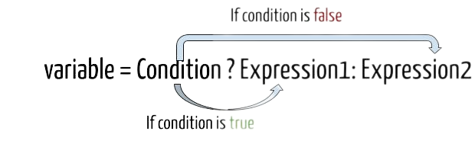
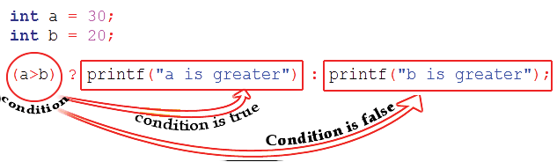
Syntax of Conditional Operator :
What this expression says is, if Condition is true, then the value returned will be Expression1. Otherwise the value returned will be Expression2.
One example is:
Here the condition (30 > 20) is true. Hence, a is greater (true value) will be output.

Slide 6
Problem solve using Ternary Operator :
Ques. Find the largest number among three numbers using conditional operator.
#include <stdio.h>
int main() {
int a, b, c, max;
printf("Enter three numbers: ");
scanf("%d %d %d", &a, &b, &c);
max = (a > b) ? ((a > c) ? a : c) : ((b > c) ? b : c);
printf("The largest number is %d", max);
return 0;
}
In this code, we first declare three integer variable a, b, c and a variable max to store the largest number. We then ask the user to input three numbers using scanf() function.
Next, we use the ternary operator to check which number is the largest among a,b and c. The ternary operator is used as follows:
(Condition) ? (value_if_true) : (value_if_false).
We first check whether a is grater than b. If it is true, then we check whether a is greater than c.If
it is, then we assign the value of a to max. If a is not greater than c then we assign the
value of c to max.
Again, if a is not greater than b, then we check whether b is greater than c. If it is,
then we assign the value of b to max. If b is not greater than c, then we assign the value
of c to max.
Finally we print the value of max as the largest number among the three given numbers.

Slide 7

Advantages of Conditional Operator:
Conciseness: The conditional operator allows you to write a conditional statement in a more concise way than if...else. This can make the code more readable and easier to understand, especially if the conditional statement is simple.
Avoiding repetition: The conditional operator can be useful in situations where you need to assign a value to a variable based on a condition.
Efficiency: In some cases, the conditional operator can be more efficient than if...else because it does not require a separate branch for each condition. This can make a difference in performance-critical code.

Slide 8
Use of if…else and Ternary Operator in program
Ques: Find the minimum number among three numbers.
//using if…else
#include <stdio.h>
int main() {
int a, b, c,min;
printf("Enter three numbers: ");
scanf("%d %d %d", &a, &b, &c);
if (a<b){
if (a<c)
min = a;
else
min = c;}
else{
if (b<c)
min = b;
else
min = c;}
printf("The minimum number is %d", min);
return 0;
}
//using conditional operator
#include <stdio.h>
int main() {
int a, b, c, min;
printf("Enter three numbers: ");
scanf("%d %d %d", &a, &b, &c);
min = (a < b) ? ((a < c) ? a : c) : ((b < c) ? b : c);
printf("The largest number is %d", min);
return 0;
}

Slide 9
Any Question or Queries ?
THANK YOU

